Slide 1


Uncovering Opportunities for Growth: Account Sales Analysis

Slide 2
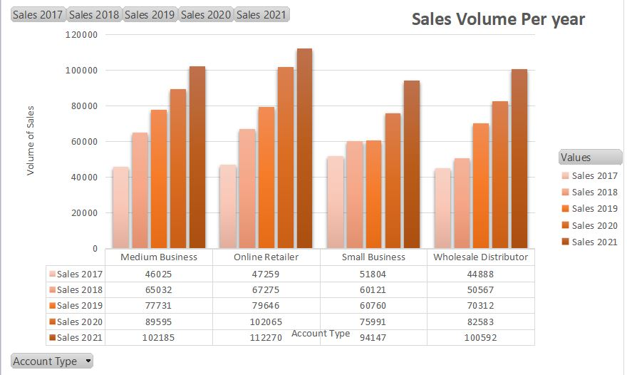
Account Sales Performance Overview
Sales have been steadily increasing over the past year.
However, a few accounts have consistently underperformed and require further attention.
Overall, there is potential for even greater growth with targeted efforts.

Slide 3
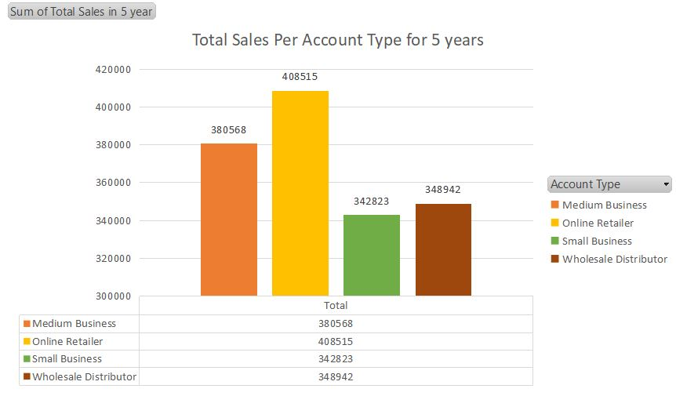
Account Type Analysis
Online Retailer accounts have consistently sold the most units.
Medium Business have also performed well.
However,Small Business and Wholesale Distributor accounts have lower sales and require additional focus to increase performance.

Slide 4
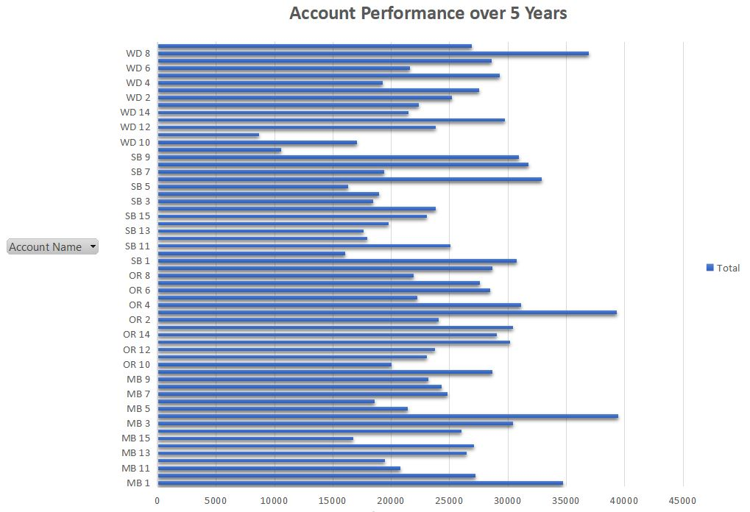
Opportunities for Improvement
By analyzing sales performance by account, we have identified opportunities for improvement across several accounts
These accounts can be prioritized for targeted efforts and increased support to improve their performance

Slide 5
Recommendation
To capitalize on the potential for even greater growth, we recommend a targeted approach focused on improving sales performance in underperforming accounts.

